Slide 1
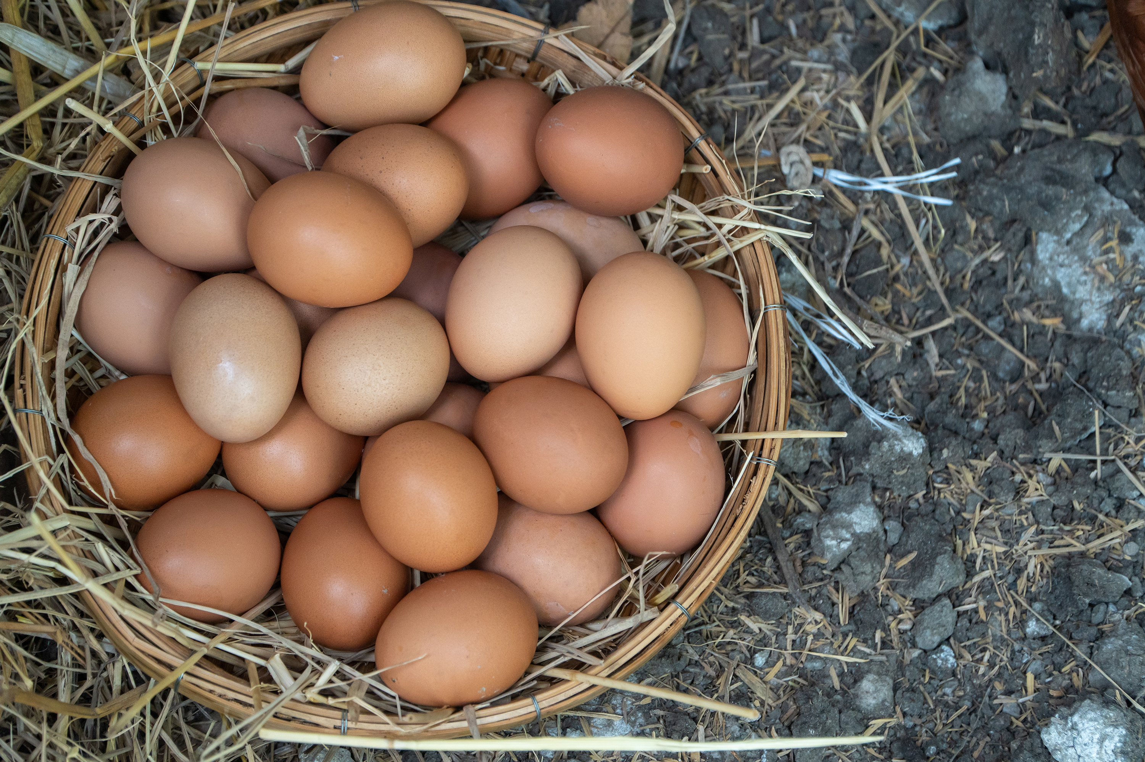

Slide 2
The Vicar’s Easter Challenge

Slide 3
…with a difference…

Slide 4
…this time we aren’t
protecting the egg…

Slide 5
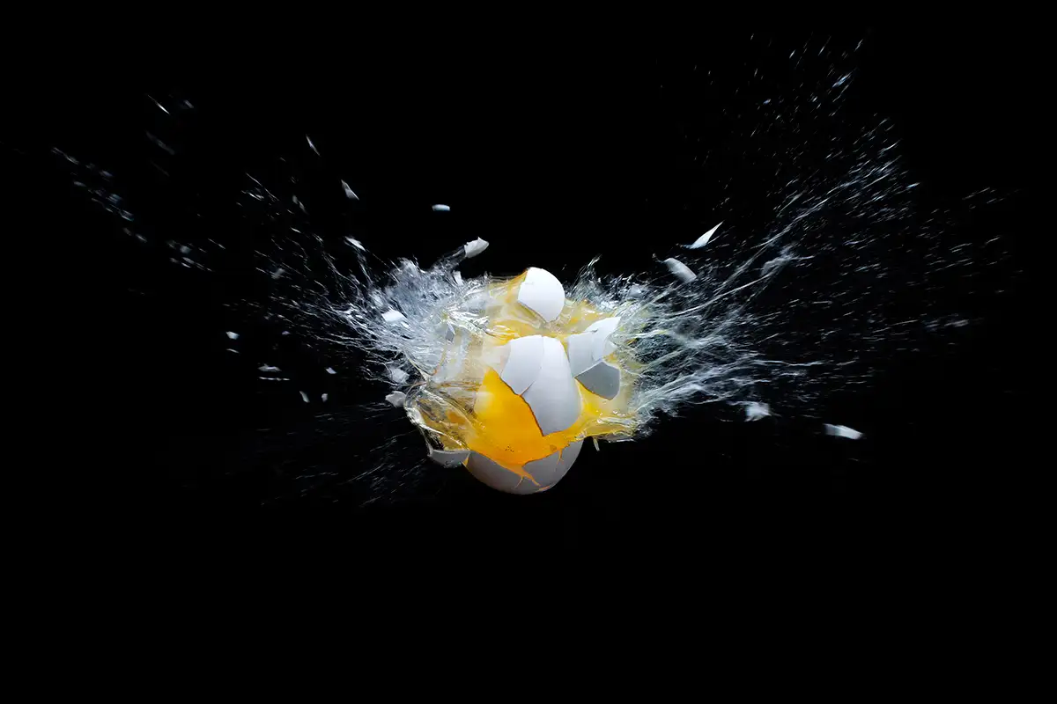

Slide 6
…this time we are out to hit the egg…

Slide 7
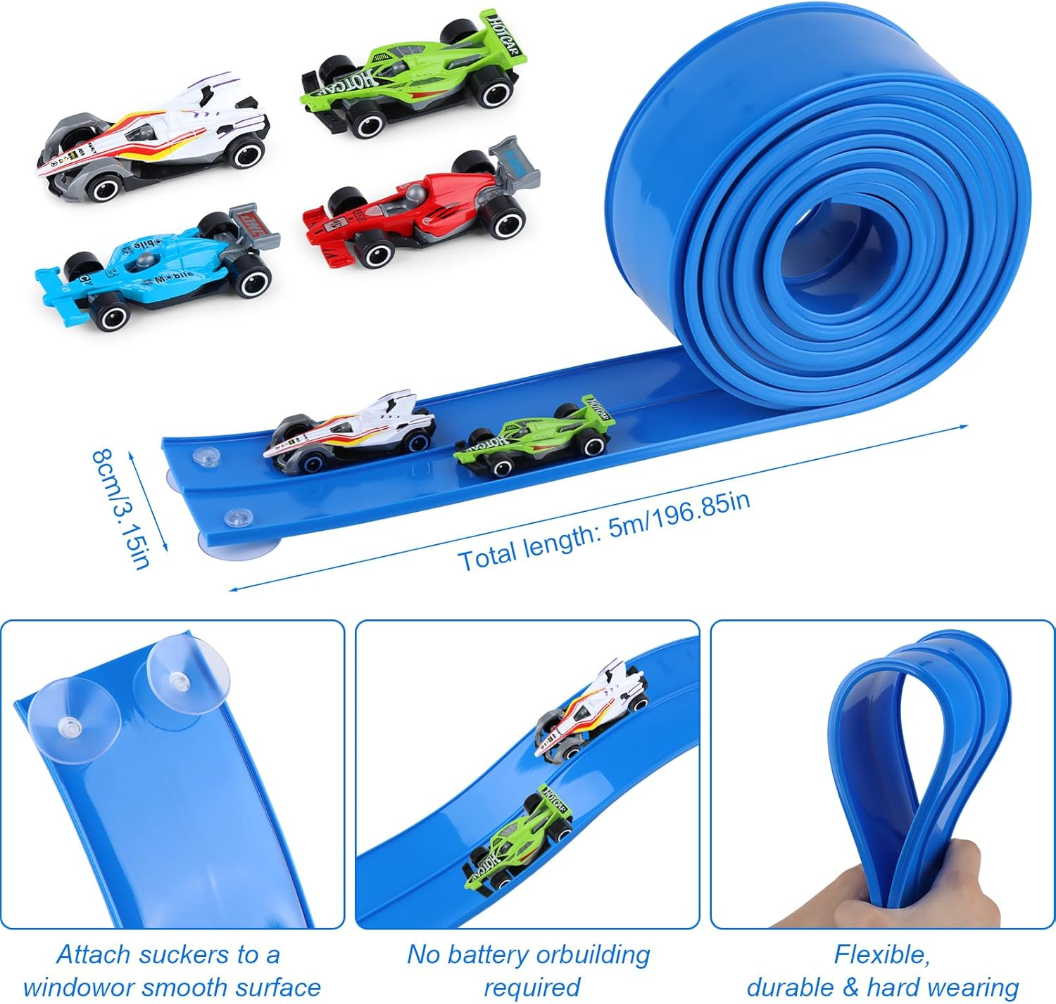

Slide 8
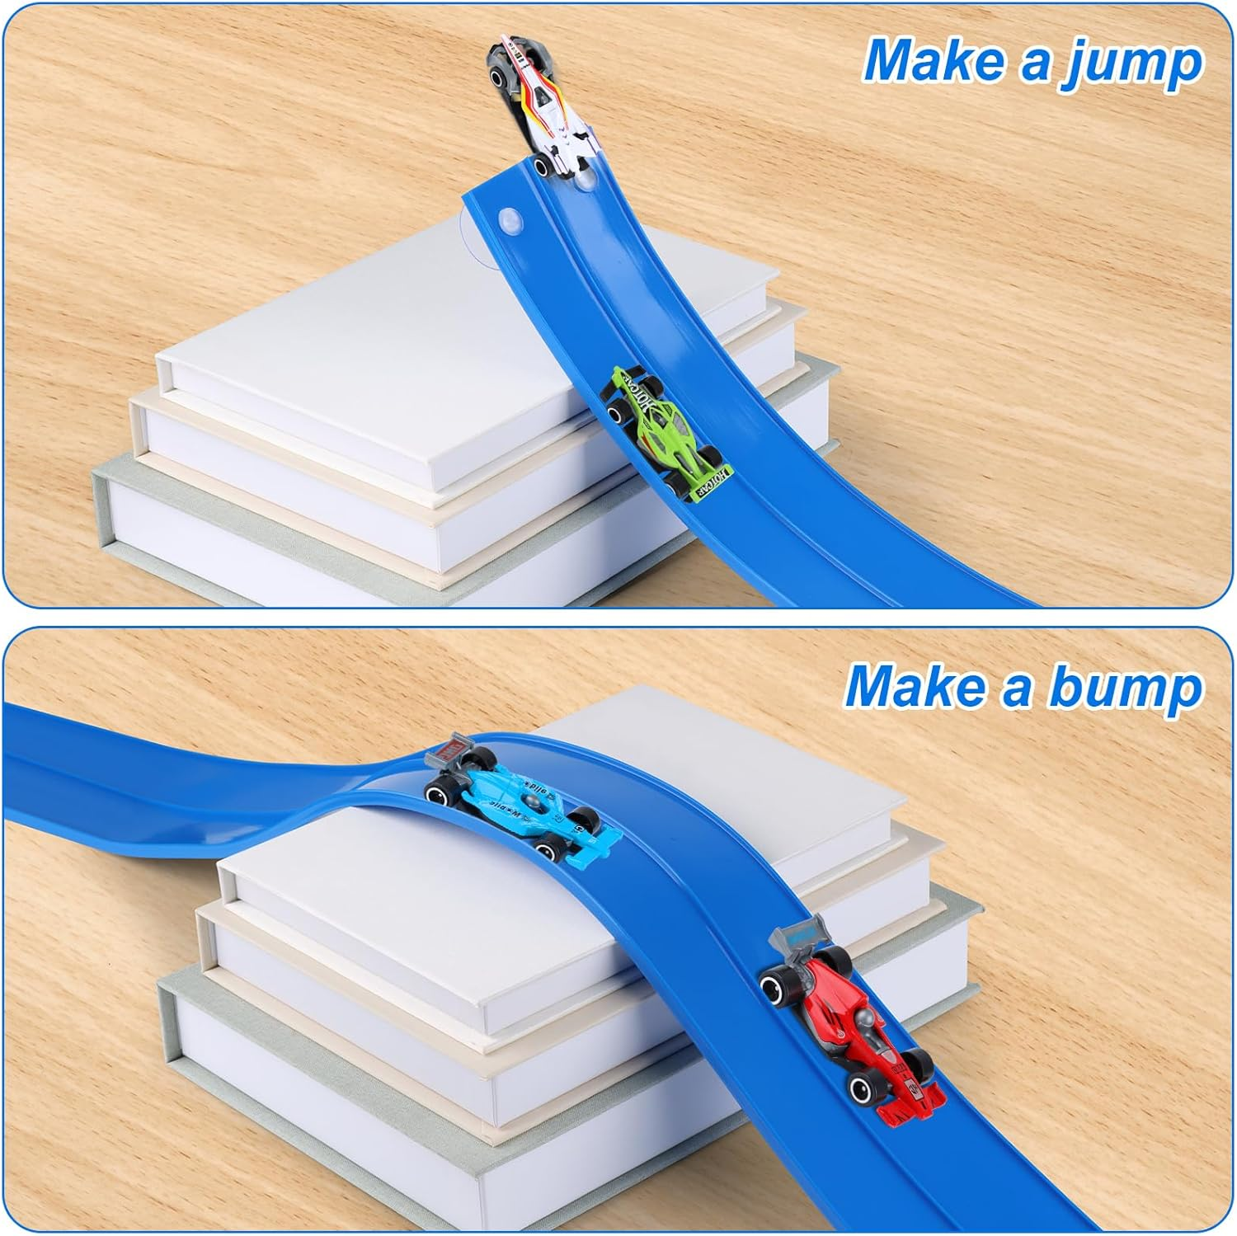

Slide 9
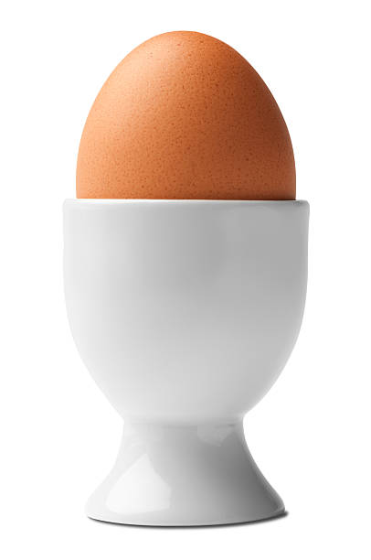

Slide 10
I suspect that fewer eggs
will get annihilated
than when we are
trying to protect them!

Slide 11
The egg
will be sat in an eggcup
in a tray

Slide 12
The challenge will be to create
a vehicle that fits in the track
(8cm in total across)

Slide 13
It needs to run smoothly and quickly
down the track.
Then up the jump at the end,
then hit the egg!
Simple?

Slide 14
My dogs will be waiting to see
how many eggs they get
for their tea!

Slide 15
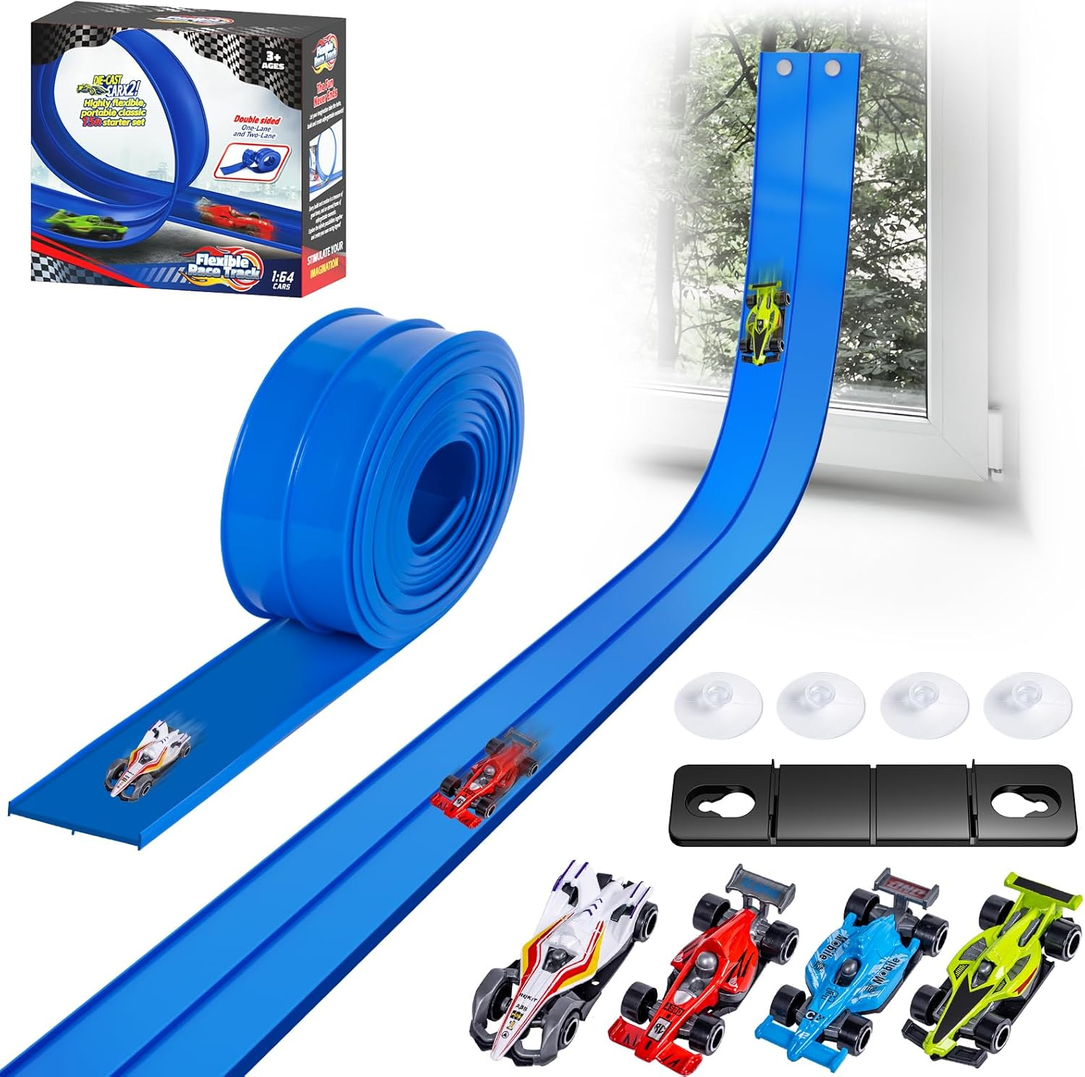

Slide 16
Questions?

