Slide 1

Welcome to Beech Class
Information for parents
September 2025

Slide 2

Welcome to Beech Class
It has been a pleasure to welcome your children back into school this September.
Your class teachers are Mrs Iacono, who teaches on Mondays, Tuesdays, Wednesdays and Fridays and Mrs Ashton, who teaches on Thursdays.

Slide 3
General information
Drop off time: 8.45am - gates and doors are locked just before 9am ready for assembly to start at 9am.
Home time: 3.25pm

Slide 4
Clothing and water bottles
Please can all clothing and belongings be clearly labelled with your child’s name so we can reunite any strayed items with their owner as quickly as possible.
Please can your child bring a water bottle to school every day and a healthy snack, should they want one
Coats are needed in school every day
Cloakroom space -coat, P.E bag underneath, lunch box on top
(If your child doesn’t need a bag, please leave at home as there is not much space)

Slide 5
Mixed age classes and the curriculum
The children in Beech Class are made up of all of the year 3 children and the youngest year 4 children.
They receive a broad and balanced curriculum based upon year group objectives from the National Curriculum.
We have a rolling curriculum programme which means that no topic is repeated in any two year cycle. Some key skills may be repeated to ensure that children are secure on the basics.

Slide 6
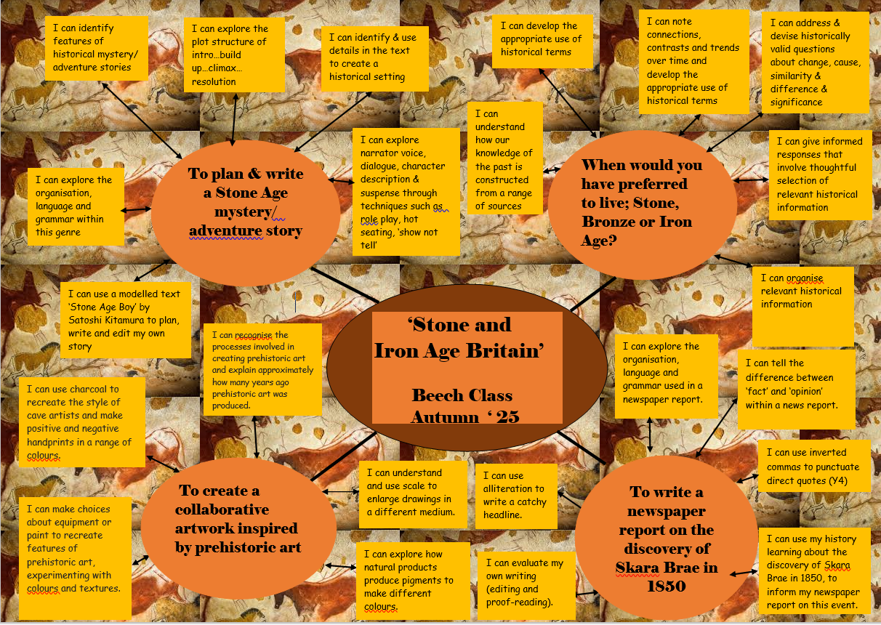
This term’s topic and key outcomes

Slide 7
Timetables
P.E. is on a MONDAY and FRIDAY. Please ensure that your child has their full PE kit in school - daps/trainers, navy blue shorts and a white t-shirt and a navy jumper for outside PE.
New spellings will be given out each Friday and the spelling test will be on Fridays.
Home learning will usually be set on a FRIDAY to be handed in by the following THURSDAY (or before!). This may occasionally change if, for example, a project homework is set.

Slide 8
School Rules
Be ready
Be respectful
Be safe

Slide 9


Reading
Please can your child have their reading book with them every day as we will read in class daily. We have a good selection of books in class which they can borrow (please can they be returned when finished!) or they are more than welcome to bring in a reading book of an appropriate level and content from home (not graphic novels).
A really important way in which you can help is to listen to your child read aloud regularly, even though it is likely that they are now increasing both accuracy and fluency. Discussing character motives, plot, historical contexts, settings etc. really helps develop comprehension skills.
Some children are reluctant readers; please do get in touch if you would like some tips on how to overcome this.
https://www.booksfortopics.com/booklists/recommended-reads/year-3/
https://www.booksfortopics.com/booklists/recommended-reads/year-4/

Slide 10


Home learning
Home learning will be set weekly on the school website and will consist of either maths or English, though from time to time we will set a ‘making’ or research project.
In addition to this, children need to read regularly at home, practise their spellings and practise their recall of times tables and basic number facts – doubling/halving etc.

Slide 11
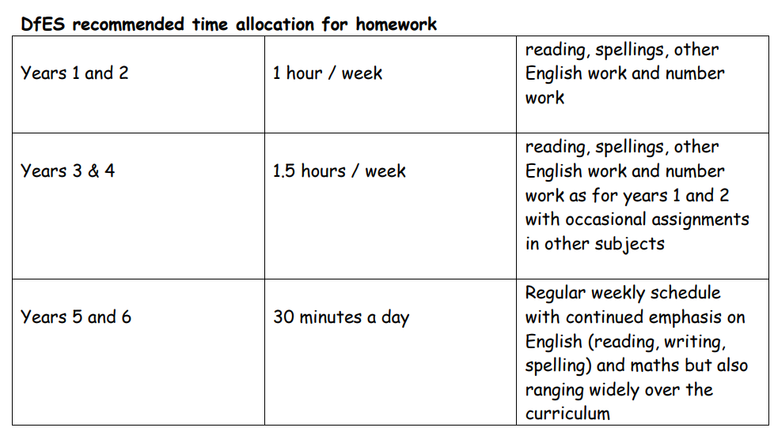
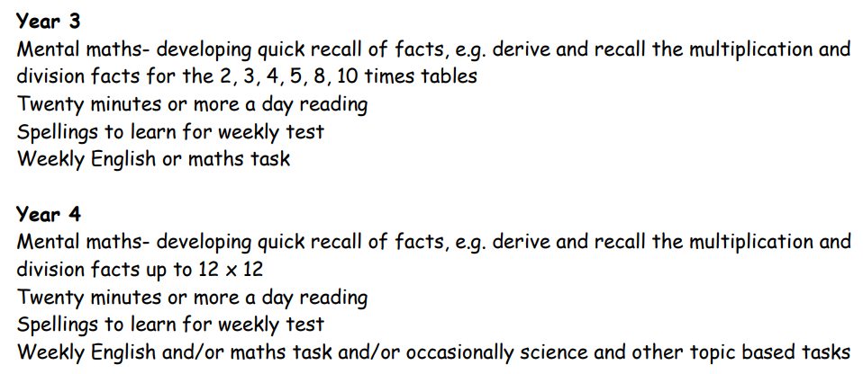
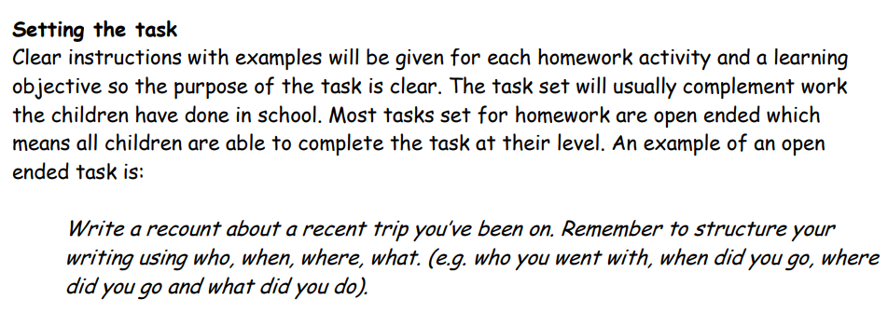

Slide 12
Rewards
Merits: Individual merits can be earned through modelling our school values, showing good behaviour, super learning, a positive attitude and completing weekly reading and homework.
Children will receive a certificate bookmark in denominations of 10 merits. Every 20 merits will be rewarded with an extra playtime.
Merit awards are celebrated in assemblies weekly.
Headteacher award: each week class teachers choose one child for a headteacher’s award, this may be linked to a school value, attitude or work.

Slide 13
Getting in touch
Please do get in touch with the class teachers if there is anything that you are unsure about or if there is anything you or your child are worried about. Please do not let a worry turn into a problem. We are available to give you a ring most days after school; the exception to this is a Wednesday which is our staff meeting day.
Thank you for your support.
Tamsin Iacono
Tamsin.iacono@box.wilts.sch.uk
Katie Ashton
Katie.Ashton@box.wilts.sch.uk

