Slide 1

Welcome to
Oak Class
Information for Parents
September 2025

Slide 2
Welcome to Oak Class
It has been a pleasure to welcome your children into Oak class this September.
The Oak class teachers are Ms Clack and Mrs Lewington on Wednesdays.
Clair Southgate is our teaching assistants

Slide 3
General information
Drop off time: 8.45am - gates and doors are locked just before 9am ready for assembly to start at 9am.
Home time: 3.25pm
If you need to get a message to the class teacher, please call the office on 01225 742663 or alternatively send an email to admin@box.wilts.sch.uk. The information will be shared quickly.

Slide 4
Clothing, snack and water bottles
Please can we request that all clothing and belongings are clearly labelled with your child’s name. We are not able to store lost property so it would be useful to reunite any strayed items with their owner as quickly as possible!
Please can the children bring a coat to school when the weather is cold and wet.
Please can your child bring a water bottle to school every day. There are water fountains but water is most useful in the classroom.
A healthy snack will be provided for child by school but if you wish for your child to bring a snack from home that’s fine too.

Slide 5
Mixed age classes and the curriculum
The children in Oak Class are made up of the Y2 children and the oldest year 1 children.
They receive a broad and balanced curriculum based upon year group objectives from the National Curriculum.
We have a rolling curriculum programme which means that no topic is repeated in any two year cycle. Some key skills may be repeated to ensure that children are secure on the basics.
The children who were in Oak Class last academic year as year 1s are now a year 2 in Oak Class with a different curriculum and expectations.

Slide 6
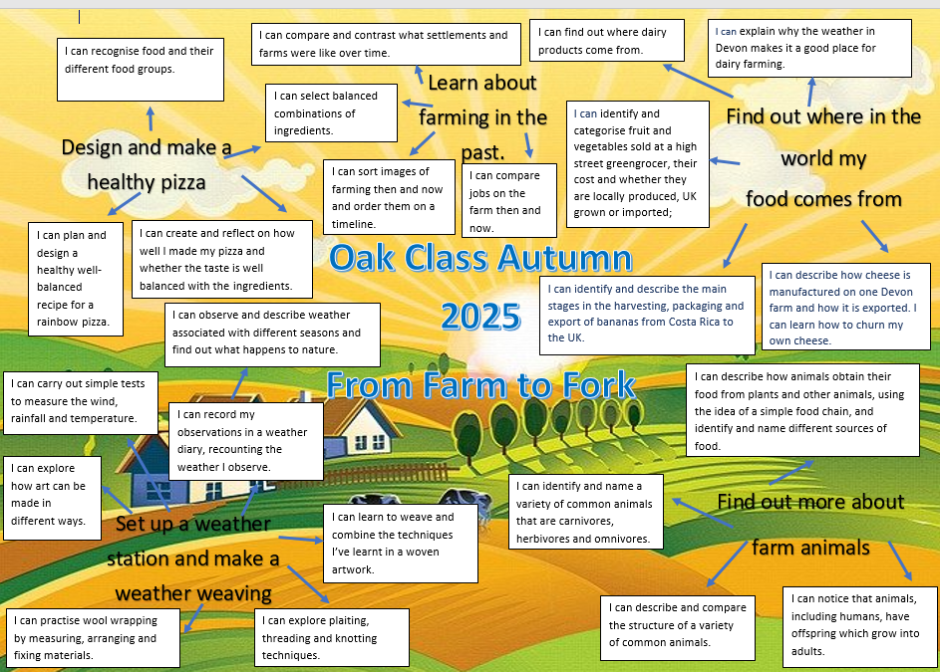
Mixed age classes and the curriculum
The children in Oak Class are made up of the youngest Y2 children and the oldest year 1 children.
They receive a broad and balanced curriculum based upon year group objectives from the National Curriculum.
We have a rolling curriculum programme which means that no topic is repeated in any two year cycle. Some key skills may be repeated to ensure that children are secure on the basics.
The children who were in Oak Class last academic year as year 1s have not been ‘kept down’ – they are now a year 2 in Oak Class with a different curriculum and expectations.

Slide 7
Timetables
P.E. is on a Monday and a Thursday. Please can your child bring in their PE kit and leave it on their peg.
Reading books need to be brought in every day and the children can keep them in their bags. Books will be changed on a weekly basis; Y1 reading books on a Monday and Y2 on a Tuesday. Children will also be able to take home a book for reading for pleasure.
Home learning will usually be set on a Friday to be handed in on the following Wednesday. This may occasionally change if, for example, a project homework is set.

Slide 8
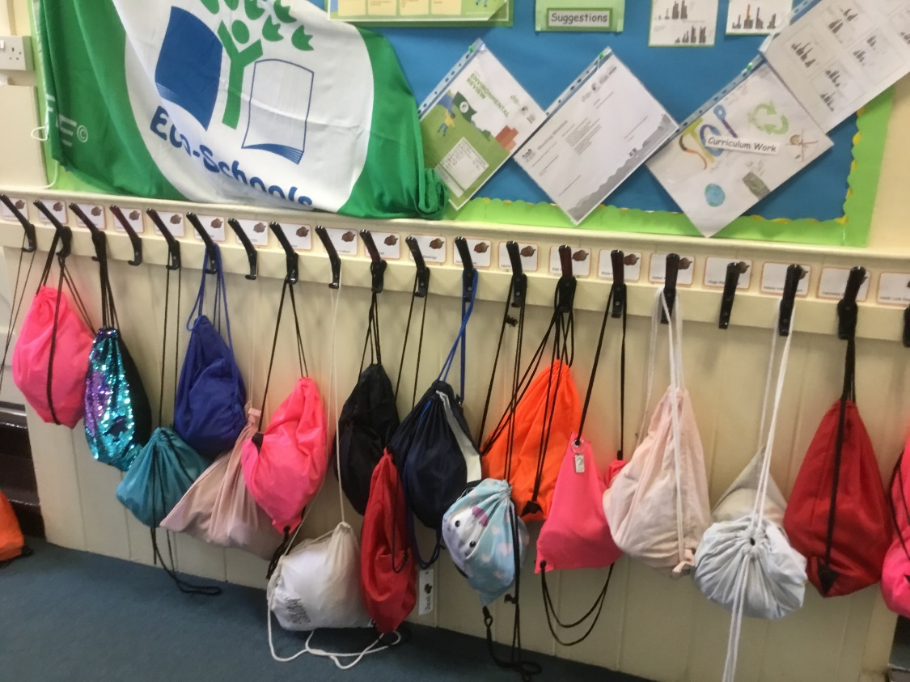
Our cloakroom
Please can we ask that book bags are used as this makes it much easier for changing books and keeping all their things together. If you have a ruck sack please keep it as empty as possible so it’s flat on their peg.

Slide 9
Celebration Assembly
We have our celebration assembly each Friday. If your child has a certificate, trophy, medal or any other award, please can this be brought into school by THURSDAY.

Slide 10
School Rules
Be ready
Be respectful
Be safe

Slide 11
Getting in touch
Please do get in touch with the class teacher if there is anything that you are unsure about or if there is anything you or your child are worried about. Please do not let a worry turn into a problem. We are available to give you a ring most days after school; the exception to this is a Wednesday which is our staff meeting day.
Thank you for your support.
Miss Clack
Catherine.Clack@box.wilts.sch.uk

