Slide 1
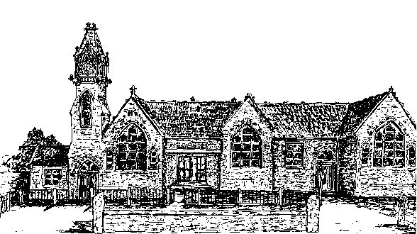
Welcome to Chestnut Class
Information for parents
September 2024

Slide 2
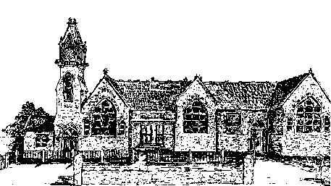
Welcome to Sycamore Class
It has been a pleasure to welcome your children back into school this September.
Your class teachers are Miss Reed, who teaches on Mondays, Tuesdays and Fridays and Mrs Ashton, who teaches on Wednesdays and Thursdays.

Slide 3
General information
Drop off time: 8.45am - gates and doors are locked just before 9am ready for assembly to start at 9am
Home time: 3.25pm

Slide 4
Clothing and water bottles
Please can your child bring a water bottle to school every day.
Please can all clothing and belongings be clearly labelled with your child’s name so we can reunite any strayed items with their owner as quickly as possible.
Please have a coat in school every day as we will go out as often as we can.
Cloakroom space

Slide 5
Mixed age classes and the curriculum
The children in Sycamore Class are made up of all of the year 6 children and the oldest year 5 children.
They receive a broad and balanced curriculum based upon year group objectives from the National Curriculum.
We have a rolling curriculum programme which means that no topic is repeated in any two year cycle. Some key skills may be repeated to ensure that children are secure on the basics.
Maths will now be taught in straight year groups across the school.
Year 5 will be taught by Miss Wells/Mrs James
Year 6 will be taught by Miss Reed/Mrs Ashton

Slide 6

This term’s topic and key outcomes

Slide 7
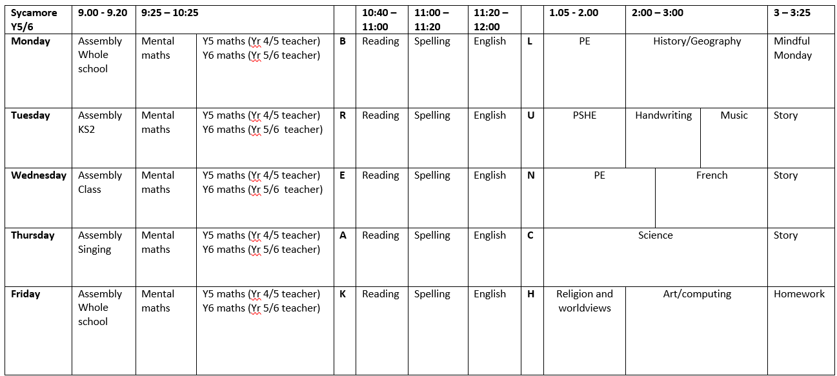
Sycamore Class Timetable

Slide 8
Timetables
PE: PE is on a Monday and a Wednesday. Please ensure that your child has their full PE kit in school - daps/trainers, navy blue shorts and a white t-shirt and a navy jumper for outside PE.
Spellings: New spellings will be given out each Friday and the spelling test will be on Fridays.
Home learning: This will usually be set on a Friday to be handed in on the following Wednesday. This may occasionally change if, for example, a project homework is set. Homework will be published weekly on the Sycamore class page of the school website.
Reading Diary: A book review needs to be completed weekly in their reading diary but do let us know if the book review is becoming a barrier to reading for pleasure. There will be suggested book review questions in the front of the reading diary.

Slide 9
Swimming
Year 5 will be swimming for two terms this year, which will take place in term 5 and 6.

Slide 10
Reading
Reading is an essential life skill and at the heart of the school curriculum. Children who enjoy reading progress well in school.
Sycamore class will have daily reading lessons and will be read a class novel at the end of the day to encourage reading for pleasure.
Ideally, children should also be reading at home daily.
A really important way in which you can help is to listen to your child read aloud regularly, even though it is likely that they are now accurate and fluent. Discussing character motives, plot, historical contexts, settings etc. really helps develop comprehension skills.
Some children are reluctant readers; please do get in touch if you would like some tips on how to overcome this.

Slide 11

Reading for Pleasure
Reading for Pleasure: Please can your child have their reading book with them every day as we will read in class daily. We have a good selection of books in class which they can borrow (please can they be returned when finished!) or they are more than welcome to bring in a reading book of an appropriate level and content from home.
Please note: we discourage magazines/graphic novels and cartoon-strip style books to be read in class but we are more than happy for these to be read at break times. ☺
This our class novel this term is: Children of the Benin Kingdom
We are always looking to recruit new volunteer readers -
Please let us know it you are interested in becoming a volunteer
at the school! ☺

Slide 12


Top 100 Recommended Reads
These are on the Sycamore class page on our school website
https://www.box.wilts.sch.uk/page/?title=Sycamore&pid=36

Slide 13
Home learning
Home learning will be set weekly and will consist of either maths or English, though from time to time we will set a ‘making’ or research project. Homework will be published weekly on the Sycamore class page of the school website.
In addition to this, children need to read regularly at home, practise their spellings and practise their recall of times tables and basic number facts – doubling/halving etc.
Children will have online logins for the applications ‘TTRock Stars’ and ‘Spelling Shed’. Children can use these anytime for additional practice.

Slide 14
School Rules
Follow instructions
Look after each other
Look after our environment
Share
Be polite
Walk around the school
Have fun

Slide 15
Class rules

Slide 16
Rewards
Merits: Individual merits can be earned through modelling our school values, showing good behavior, super learning, a positive attitude and completing weekly reading and homework.
Children will receive a certificate bookmark in denominations of 10 merits. Every 20 merits will be rewarded with an extra playtime. ☺
Merit awards are celebrated in assemblies weekly.
Headteacher award: each week class teachers chooses one child for a headteacher’s award, this may be linked to a school value, attitude or work.

Slide 17
Getting in touch
Please do get in touch with us if there is anything that you are unsure about or if there is anything you or your child are worried about. Please do not let a worry turn into a problem. We are available to give you a ring most days after school; the exception to this is a Wednesday which is our staff meeting day.
Thank you for your support.
Miss Reed- lisa-marie.reed@box.wilts.sch.uk
Mrs Ashton- Katie.ashton@box.wilts.sch.uk

