Slide 1

Welcome to
Oak Class
Information for parents
September 2024

Slide 2
Welcome to Oak Class
It has been a pleasure to welcome your children into Oak class this September.
The Oak class teacher is Miss Clack and Mrs Phillips on Wednesdays.
Chris Williams and Alison Cobb are our teaching assistants

Slide 3
General information
Drop off time: 8.45am - gates and doors are locked just before 9am ready for assembly to start at 9am.
Home time: 3.25pm
If you need to get a message to the class teacher, please call the office on 01225 742663 or alternatively send an email to admin@box.wilts.sch.uk. The information will be shared quickly.

Slide 4
Clothing, snack and water bottles
Please can we request that all clothing and belongings are clearly labelled with your child’s name. We are not able to store lost property so it would be useful to reunite any strayed items with their owner as quickly as possible!
Please can the children bring a coat to school when the weather is cold and wet.
Please can your child bring a water bottle to school every day. There are water fountains but water is most useful in the classroom.
A healthy snack will be provided for child by school but if you wish for your child to bring a snack from home that’s fine too.

Slide 5
Mixed age classes and the curriculum
The children in Oak Class are made up of the Y2 children and the oldest year 1 children.
They receive a broad and balanced curriculum based upon year group objectives from the National Curriculum.
We have a rolling curriculum programme which means that no topic is repeated in any two year cycle. Some key skills may be repeated to ensure that children are secure on the basics.
The children who were in Oak Class last academic year as year 1s are now a year 2 in Oak Class with a different curriculum and expectations.

Slide 6
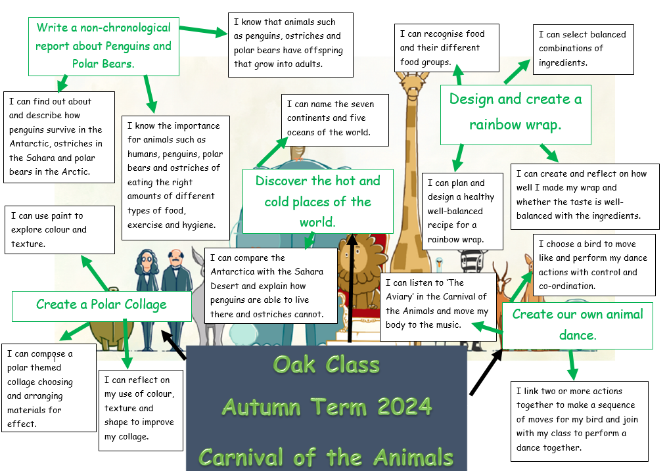
Mixed age classes and the curriculum
The children in Oak Class are made up of the youngest Y2 children and the oldest year 1 children.
They receive a broad and balanced curriculum based upon year group objectives from the National Curriculum.
We have a rolling curriculum programme which means that no topic is repeated in any two year cycle. Some key skills may be repeated to ensure that children are secure on the basics.
The children who were in Oak Class last academic year as year 1s have not been ‘kept down’ – they are now a year 2 in Oak Class with a different curriculum and expectations.

Slide 7
Timetables
P.E. is on a Monday and a Wednesday. Please can your child bring in their PE kit and leave it on their peg.
New spellings will be given out each Friday and the spelling test will be at the end of the week on the Friday.
Home learning will usually be set on a Thursday to be handed in on the following Wednesday. This may occasionally change if, for example, a project homework is set.

Slide 8
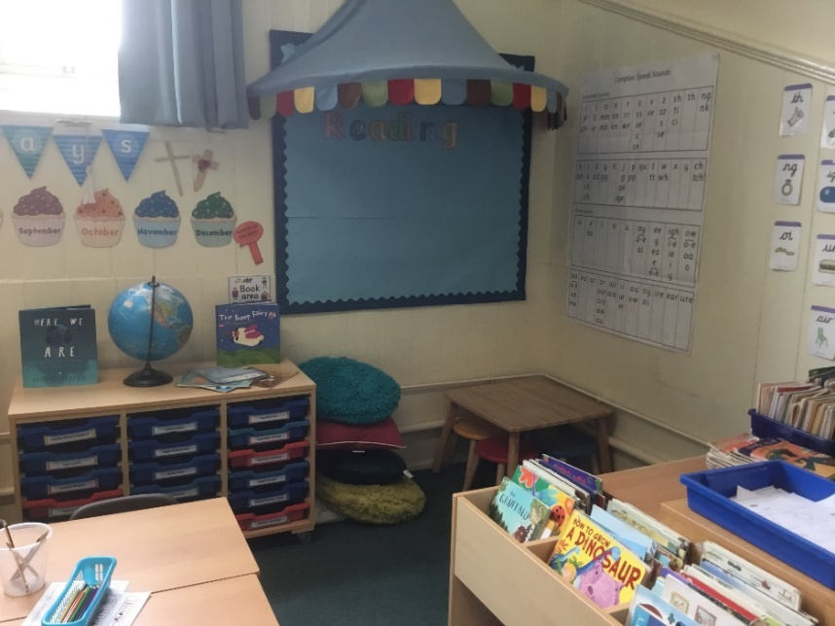
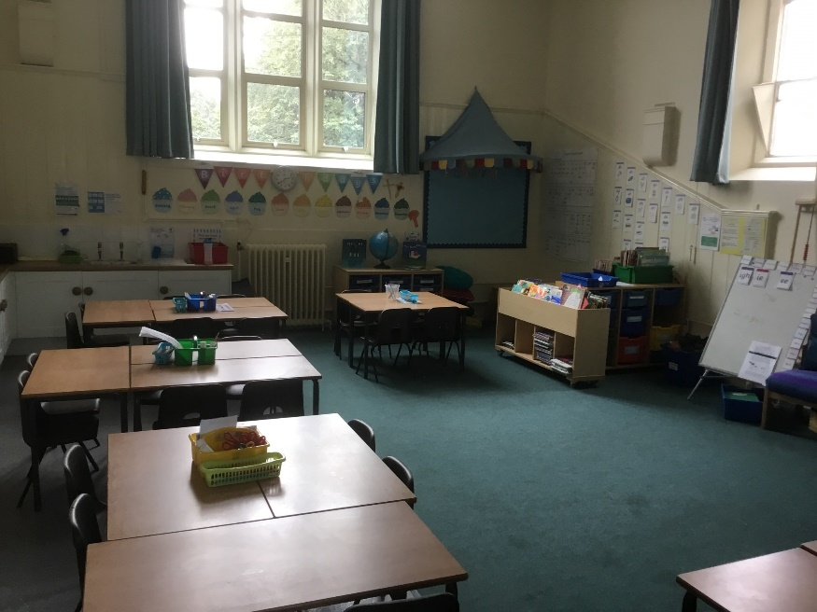
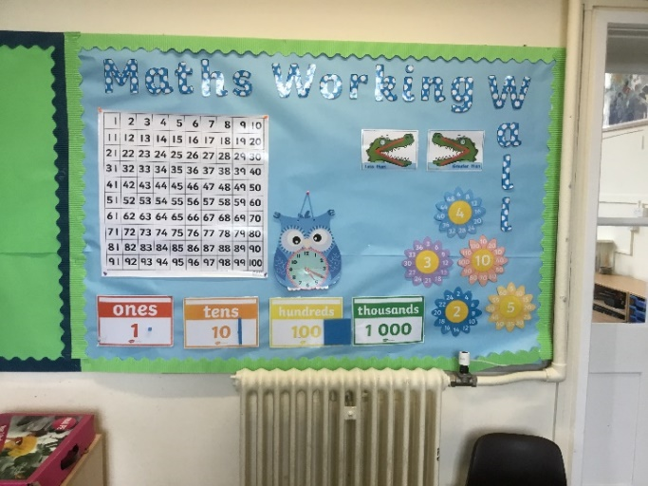
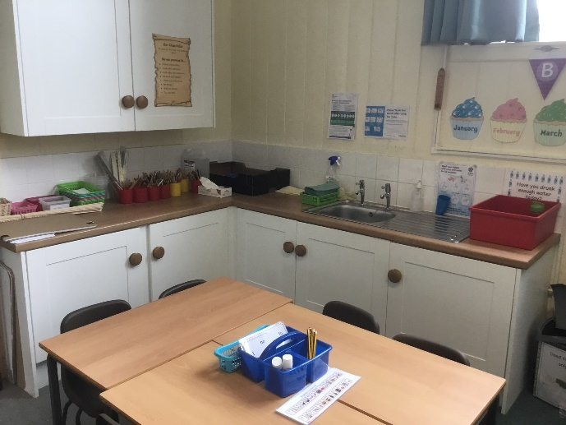
Our Classroom

Slide 9
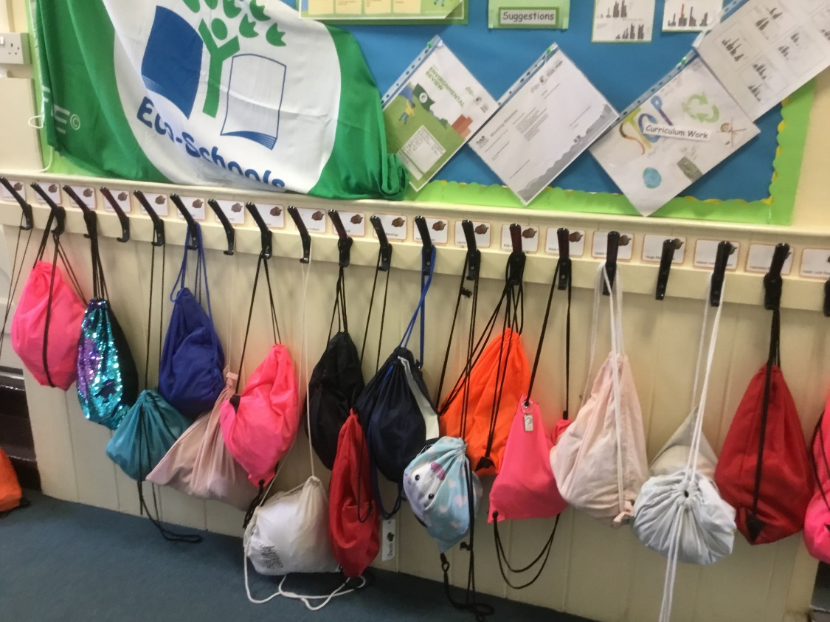
Our cloakroom
Please can we ask that book bags are used as this makes it much easier for changing books and keeping all their things together. If you have a ruck sack please keep it as empty as possible so it’s flat on their peg.

Slide 10
Reading
We will be changing books on a Monday and need all books in on that day but also every day. If a child has read a book several times and is now fluent – they can read without hesitation and decoding, then they put it in the basket to change. The adult will always check before changing and then alongside the child choose a book. They can also choose a quality picture book to read for pleasure with you at home. This is not one we would expect them to read by themselves. A reading diary record will be provided for parents to log all reading that takes place at home.

Slide 11
A really important way in which you can help is to listen to your child read aloud regularly. Discussing what’s happening in the story, making predictions, character motives, plot, historical contexts, settings etc. really helps develop comprehension skills.
Some children are reluctant readers; please do get in touch if you would like some tips on how to overcome this.

Slide 12
Home Learning
Spellings – will go out each Friday in a blue book. Children need to practice them little and often for a ‘check’ the following Friday. Please remember blue spelling books in school every Friday.
Home learning – each Thursday. This could be related to their topic or consolidation of Maths or English learning for the week. It will be given out in an orange book and the children need to return it on Wednesday to be marked. Books not in on Wednesday will not be marked.

Slide 13
Celebration Assembly
We have our celebration assembly each Friday. If your child has a certificate, trophy, medal or any other award, please can this be brought into school by THURSDAY.

Slide 14
School Rules
Follow instructions
Look after each other
Look after our environment
Share
Be polite
Walk around the school
Have fun

Slide 15
Class rules
Follow instructions.
Be Kind to each other.
Keep the classroom tidy and look after things in it.
Listen carefully and work hard.
Be polite – treat others as you would like to be treated.
Keep safe by walking around the classroom.

Slide 16
Getting in touch
Please do get in touch with the class teacher if there is anything that you are unsure about or if there is anything you or your child are worried about. Please do not let a worry turn into a problem. We are available to give you a ring most days after school; the exception to this is a Wednesday which is our staff meeting day.
Thank you for your support.
Miss Clack
Catherine.Clack@box.wilts.sch.uk

