Slide 1

Welcome to Beech Class
Information for parents
September 2023

Slide 2
Welcome to Beech Class
It has been a pleasure to welcome your children back into school this September.
Beech class teachers are Mrs Phillips, who teaches on Mondays, Tuesdays and Mrs Stevenson, who teaches on Wednesday, Thursdays and Fridays.
Wednesday afternoons are alternated between Mrs Phillips and Mrs Stevenson.
The teaching assistants are Mrs Cobb - some mornings from 8:55 to break time and Mrs Roberts who helps with our maths lessons

Slide 3
General information
Drop off time: 8.45am
Register at 8:55am
Break - 10:25am
Lunch – 11:55 to 12:55
Home time: 3.25pm

Slide 4
Clothing and water bottles
Please can all clothing and belongings be clearly labelled with your child’s name so we can reunite any strayed items with their owner as quickly as possible.
Please can your child bring a water bottle to school every day. The water fountains are back in use for break times.
Coat – even for slightly wet days to enable them to go out to play. Also for walking down to the church or Selwyn Hall
Cloakroom space

Slide 5
Mixed age classes and the curriculum
The children in Beech Class are made up of the youngest year 4 and the oldest year 3 children.
They receive a broad and balanced curriculum based upon year group objectives from the National Curriculum.
We have a rolling curriculum programme which means that no topic is repeated in any two year cycle. Some key skills may be repeated to ensure that children are secure on the basics.
The children who were in Beech Class last academic year as year 3s are now a year 4 in Beech Class with a different curriculum and expectations.

Slide 6
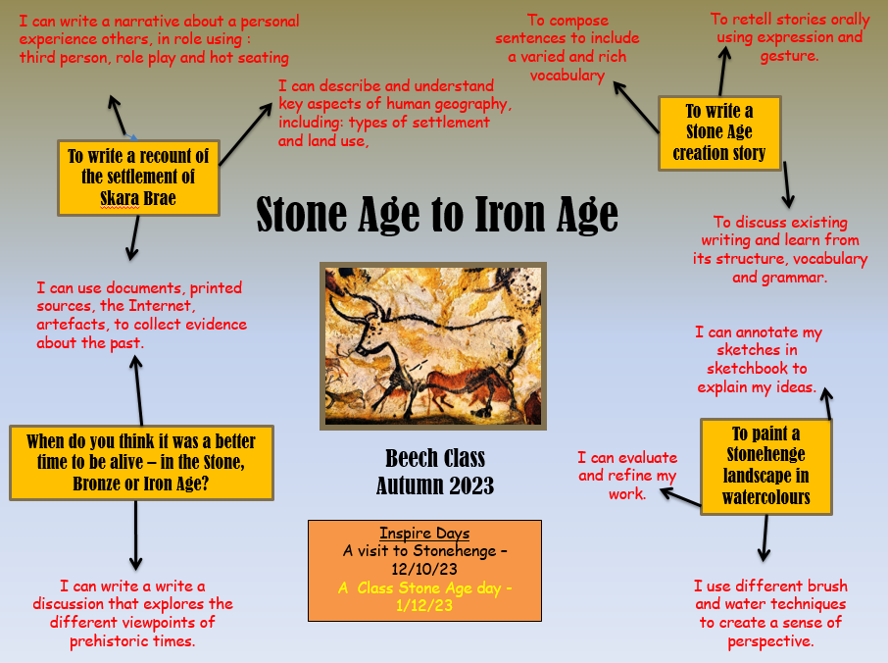
This term’s topic and key outcomes is on the website

Slide 7
Timetables – on the website
P.E. is on a Wednesday and a Friday. Please can your child have a full PE kit in school - trainers/daps, shorts (black or blue) and a white T-shirt. They might want to have joggers and a hoody – for going outside.
Swimming starts next week – September 20th
Swimming for Year 4s will continue until February 2024. At this point all Year 3s will then swim until February 2025

Slide 8
Timetables – on the website
P.E. is on a Wednesday and a Friday. Please can your child have a full PE kit in school - trainers/daps, shorts (black or blue) and a white T-shirt. They might want to have joggers and a hoody – for going outside.
New spellings will be given out each Friday and the spelling test will be on Fridays.
Home learning will usually be set on a Wednesday to be handed in on the following Tuesday. This may occasionally change if, for example, a project homework is set.

Slide 9
School Rules
Follow instructions
Look after each other
Look after our environment
Share
Be polite
Walk around the school
Have fun

Slide 10
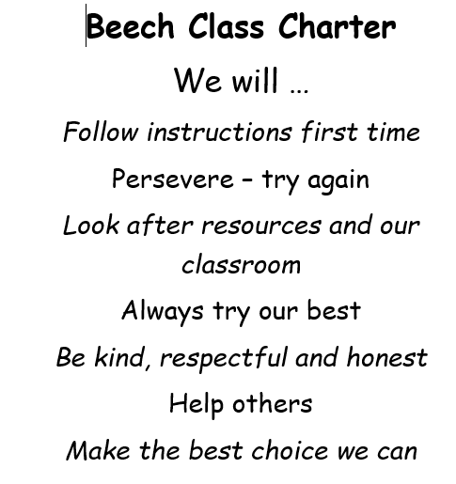

Slide 11
Reading
Please can your child have their reading book with them every day as we will read in class daily. We have a good selection of books in class which they can borrow (please can they be returned when finished!) or they are more than welcome to bring in a reading book from home.
A really important way in which you can help is to listen to your child read aloud regularly, even though it is likely that they are now accurate and fluent. Discussing character motives, plot, historical contexts, settings, predicting etc. really helps develop comprehension skills.
Some children are reluctant readers; please do get in touch if you would like some tips on how to overcome this.

Slide 12
Home learning
Home learning will be set weekly and will consist of either maths or English, though from time to time we will set a ‘making’ or research project. You will find a copy of the homework policy on the school website
In addition to this, children need to read regularly at home, practise their spellings and practise their recall of times tables and basic number facts – doubling/halving etc.

Slide 13
Year 4 residential
All year 4s have an opportunity to take part in the residential trip to Braeside Activity Centre in Devizes.
There will be more information to follow but the dates are Monday 22nd May to Wednesday 24th May 2024.
Activities include; Canal walk, low ropes, archery, night line, 6 mile walk, orienteering, bouldering and survival skills.

Slide 14
Getting in touch
Please do get in touch with the class teachers if there is anything that you are unsure about or if there is anything you or your child are worried about. Please do not let a niggle or a worry turn into a problem.
We are available to give you a ring most days after school; the exception to this is a Wednesday which is our staff meeting day.
Thank you for your support.
Mrs Phillips and Mrs Stevenson
nicola.phillips@box.wilts.sch.uk
janine.stevenson@box.wilts.sch.uk

