Slide 1

Welcome to Chestnut Class
Information for parents - September 2022

Slide 2

Welcome to Chestnut Class
It has been a pleasure to welcome your children back into school this September.
Chestnut class teacher is Miss Long. Her PPA and Subject time is covered by Mrs Hobbs (Wednesday morning –fortnightly) and Mrs James (Wednesday afternoons).
Chestnut Class Teaching Assistant is Mrs Cobb.

Slide 3
Clothing and water bottles
Please can all clothing and belongings be clearly labelled with your child’s name so we can reunite any strayed items with their owner as quickly as possible.
Please can your child bring a water bottle to school every day as they are not able to use the water fountains at the moment.
In Ks2 our cloakrooms are smaller and so we ask that the children only bring in their bag, PE and coat. Please can bags we kept as small as possible to ensure there is enough room.

Slide 4
Mixed age classes and the curriculum
The children in Chestnut Class are made up of all of the year 5 children and the oldest year 4 children.
They receive a broad and balanced curriculum based upon year group objectives from the National Curriculum.
We have a rolling curriculum programme which means that no topic is repeated in any two year cycle. Some key skills may be repeated to ensure that children are secure on the basics.
The children who were in Chestnut Class last academic year as year 4s are now a year 5 in Chestnut Class with a different curriculum and expectations.

Slide 5
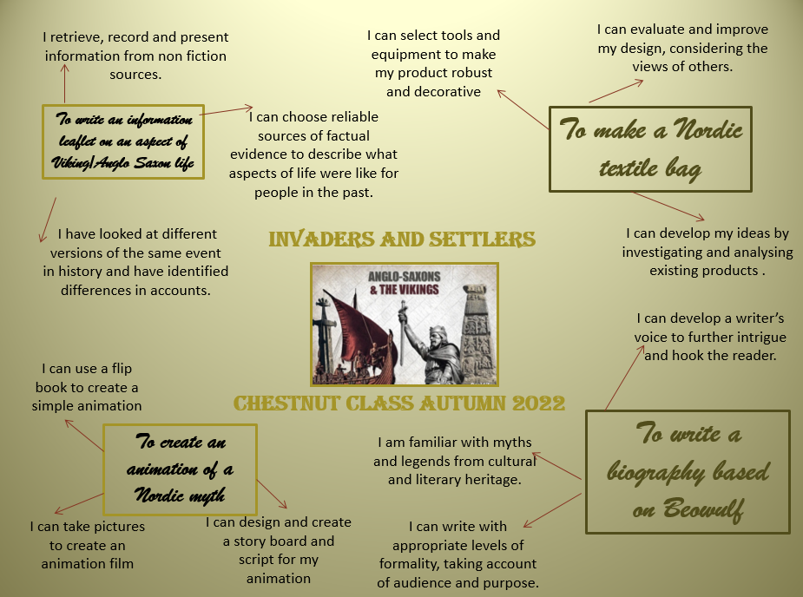
This term’s topic and key outcomes

Slide 6
Timetables
P.E. is on a Tuesday and a Wednesday and a full PE kit is needed.
New spellings will be given out each Friday and the spelling test will be on the following Friday.
Homework will usually be set on a Friday to be handed in on the following Wednesday. This may occasionally change if, for example, a project homework is set.
A book review needs to be completed weekly in their reading diary but do let us know if the book review is becoming a barrier to reading for pleasure.

Slide 7
School Rules
Follow instructions
Look after each other
Look after our environment
Share
Be polite
Walk around the school
Have fun

Slide 8
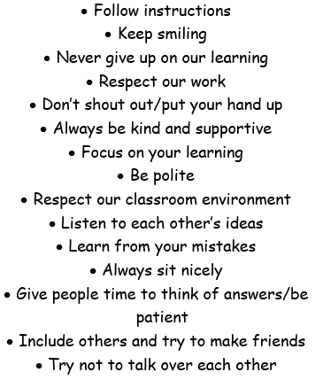
Class rules

Slide 9
Reading
Please can your child have their reading book with them every day as we will read in class daily. We have a good selection of books in class which they can borrow or they are more than welcome to bring in a reading book from home.
Some children are reluctant readers; please do get in touch if you would like some tips on how to overcome this.
A really important way in which you can help is to listen to your child read aloud regularly, even though it is likely that they are now accurate and fluent. Discussing character motives, plot, historical contexts, settings etc. really helps develop comprehension skills.

Slide 10
Home learning
Home learning will be set weekly and will consist of either maths or English, though from time to time we will set a ‘making’ or research project. You will find a copy of the home work policy on the school website
In addition to this, children need to read regularly at home, practise their spellings and practise their recall of times tables and basic number facts – doubling/halving etc.

Slide 11
Getting in touch
Please do get in touch with the class teachers if there is anything that you are unsure about or if there is anything you or your child are worried about. Please do not let a worry turn into a problem. We are available to give you a ring most days after school; the exception to this is a Wednesday which is our staff meeting day.
Thank you for your support.
Miss Long
Lottie.long@box.wilts.sch.uk

