Slide 1

Welcome to Willow Class
Information for parents
September 2022

Slide 2


Welcome to Willow Class
It has been a pleasure to welcome your children back into school this September.
The Willow class teachers are Mrs Tamsin
Iacono who teaches on Mondays, Tuesdays,
Wednesdays and Fridays and Mrs Katie
Ashton who teaches on a Thursday.
The teaching assistant is Barbara Baleani.

Slide 3
Clothing and water bottles
Please can all clothing and belongings be clearly labelled with your child’s name so we can reunite any strayed items with their owner as quickly as possible.
Please can your child bring a water bottle to school every day.
Please can all children also make sure they have a coat in school as the weather can change very quickly.
We do not have a lot of cloakroom space so it would be appreciated if back packs could be on the smaller side! It is also useful if the children have some sort of book back to take reading/spelling/homework books etc up to the classroom.

Slide 4
Mixed age classes and the curriculum
The children in Willow Class are made up of the oldest year 2 children and the youngest year 3 children.
They receive a broad and balanced curriculum based upon year group objectives from the National Curriculum.
We have a rolling curriculum programme which means that no topic is repeated in any two year cycle. Some key skills may be repeated to ensure that children are secure on the basics.
The children who were in Willow Class last academic year as year 2s are now a year 3 in Willow Class with a different curriculum and expectations.

Slide 5
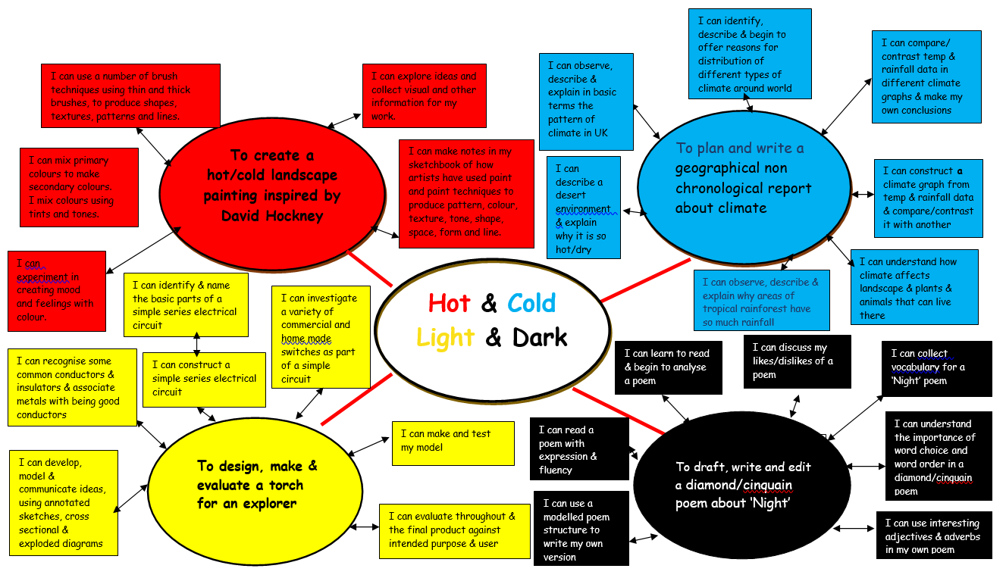
This term’s topic and key outcomes

Slide 6
Timetables
P.E. is on a Monday and a Friday. Please can your child bring in PE kit for the relevant days. PE kit consists of a white t-shirt, blue shorts and either trainers or daps. For the colder months a hoody and leggings/tracksuit bottoms are recommended.
New spellings will be given out on a Friday each week and the spelling test will be on the following Friday.
Home learning will usually be set on a Friday to be handed in by the following Thursday.
Reading records need to be completed every time your child reads at home. Year 3 pupils with a reading diary need to try and complete an entry once per week using the questions stuck at the front of the diary as a guide. Do please let me know if you feel this is becoming a barrier to reading for pleasure.

Slide 7
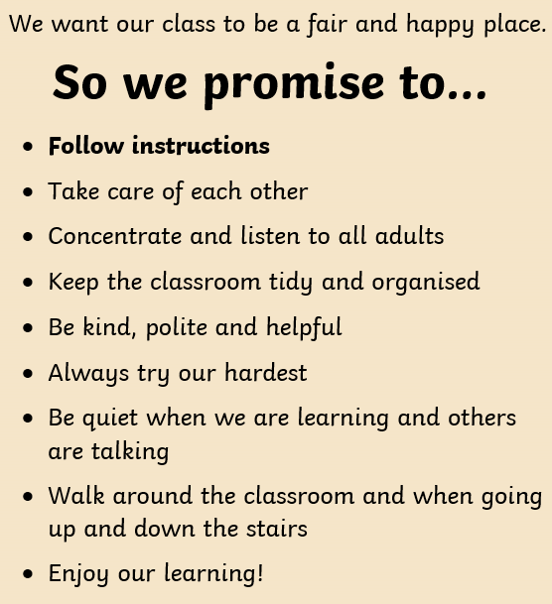
School Rules Willow Class Rules
Follow instructions
Look after each other
Look after our environment
Share
Be polite
Walk around the school
Have fun

Slide 8
Reading
Please can your child have their book bag with them every day. Children need to put their current book and reading record/diary in the box in the classroom each morning so that we can quickly see when it needs to be changed.
In class, children are reading all day, every day not just from their reading book. Every day we have 10 minutes individual reading time when all children are reading from their own phonics level matched book. Children also do whole class and group reading sessions.
A really important way in which you can help is to listen to your child read aloud regularly. Discussing the book, using the guidance in the front/back pages of the phonics book, or using the questions in the reading diary (for those years 3s who have one), really helps develop comprehension skills. The most important thing is that the children’s love of reading is developed.

Slide 9
Home learning
Home learning will be set weekly and will mostly consist of either maths or
English. This will come home in the children’s homework book and can also be found on the class page of the website.
You will find a copy of the home work policy on the school website.
In addition to this, children need to read regularly at home, practise their spellings and practise their recall of times tables and basic number facts – doubling/halving etc.

Slide 10
Getting in touch
Please do get in touch with me if there is anything that you are unsure about or if there is anything you or your child are worried about. Please do not let a worry turn into a problem. I am available to give you a ring most days after school; the exception to this is a Wednesday which is our staff meeting day.
Thank you for your support.
Mrs Tamsin Iacono and Mrs Katie Ashton
tamsin.iacono@box.wilts.sch.uk
katie.ashton@box.wilts.sch.uk

